Slide 1


Introduction to Continuous Integration
Peter Veres
peter_veres2@epam.com
2017

Slide 2

What is Continuous Integration?

Slide 3
What is Continuous Integration?
Continuous Integration is a software development practice where members of a team integrate their work frequently, usually each person integrates at least daily - leading to multiple integrations per day. Each integration is verified by an automated build (including test) to detect integration errors as quickly as possible. Many teams find that this approach leads to significantly reduced integration problems and allows a team to develop cohesive software more rapidly.
Martin Fowler

Slide 4
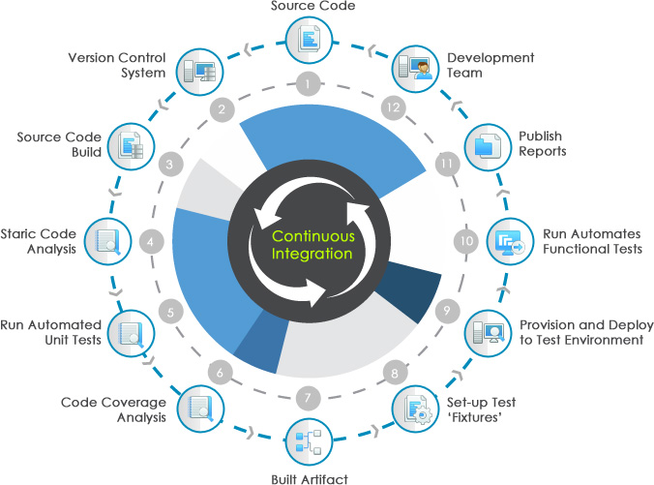
CI Phases

Slide 5
CI Principles
Maintain common code repository
Frequent integration with mainline
Automated, fast build
Automated unit-testing as part of build
Dev, Test environments as clone of production

Slide 6
Continuous Delivery & Deployment
Continuous Integration
General idea of frequent integration, automated unit tests, build automation, etc.
Continuous Delivery
Product in mainline is always ready to be shipped to UAT/QA
Continuous deployment to UAT
Batched deployment to PROD
Continuous Deployment
Automated deployment to PROD
Might not be in line with company policy

Slide 7





CI Stack components & tools
Version Control System (Git, SVN, CVS, Mercurial)
VCS Manager (GitHub)
Software Project Management (Maven, Ant, Graddle)
CI Servers (Jenkins, TeamCity, Bamboo)
Repository Management (Nexus, Artifactory)
Code Review, Documentation, Issue Tracking

Slide 8
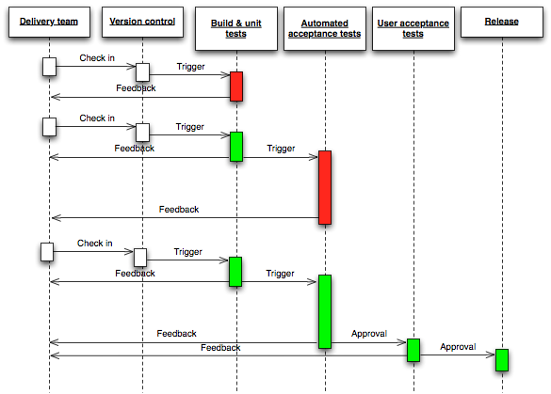
CI Pipeline

Slide 9
CI SERVER (JENKIINS)
Maven in Real Projects

Slide 10
Jenkins
Jenkins is an award-winning, cross-platform, continuous integration and continuous delivery application that increases your productivity. Use Jenkins to build and test your software projects continuously making it easier for developers to integrate changes to the project, and making it easier for users to obtain a fresh build. It also allows you to continuously deliver your software by providing powerful ways to define your build pipelines and integrating with a large number of testing and deployment technologies.

Slide 11

Jenkins features
Free
Core distribution
Lots of public plugins
Extensibility - team can develop their own plugins with Jenkins API
Scalability – multiple slaves (agents)

Slide 12
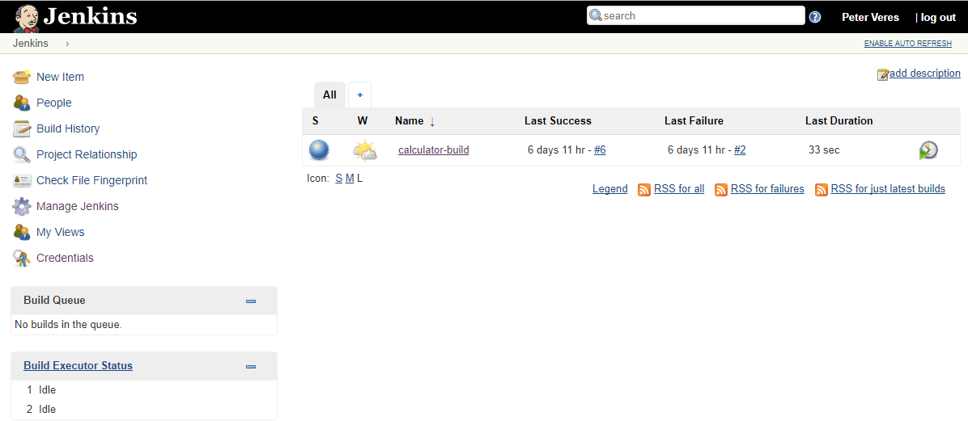
Login to Jenkins
URL: http://localhost:8080
Admin credentials: admin/*****
Login to Jenkins with admin rights!

Slide 13
Jenkins - Junior Program CI – Build
How does it work?
Jenkins Agent
Git fetch
workspace
Git Repo
Local repository
Remote Nexus
mvn clean install
mvn clean deploy
Try to run build manually!

Slide 14
Configure Jenkins Job
Main sections:
Header (Maven project name, Project description, etc.)
Source Code Management (Git, URL, credentials, Branch Specifier – master)
Build trigger (Poll scm – Cron trigger)
Build commands („mvn clean deploy”)
Let’s check Calculator CI – Build

Slide 15
Jenkins Build trigger
Polls periodically SCM (Cron trigger)
Upon code change, it initiates a build
Only when branch filter matches

Slide 16
Deployment
Maven in Real Projects

Slide 17
Deployment with Jenkins
Jenkins controls the process
Downloads binaries from Nexus
Deploys binaries to target environment
Stops/restarts remote process if needed
Maven can help in automating deployment!
Remote Nexus
Target Environment
Jenkins

Slide 18
Repository Management (NexuS)
Maven in Real Projects

Slide 19
Nexus
A repository manager is a dedicated server application designed to manage repositories of binary components. The usage of a repository manager is considered an essential best practice for any significant usage of Maven.

Slide 20
Deployment to remote repository
„deploy” instructs Maven do deploy artifact(s) to remote repository defined in distribution management
Local repository
Remote repository
mvn clean deploy
<project>
<distributionManagement>
<repository>
<id>juniorprogram_ci</id>
<url>http://localhost:8081/nexus/content/repositories/juniorprogram_ci_releases</url>
</repository>
<snapshotRepository>
<id>juniorprogram_ci</id>
<url>http:// localhost :8081/nexus/content/repositories/juniorprogram_ci_snapshots</url>
</snapshotRepository>
</distributionManagement>
</project>

Slide 21
Nexus characterisrics
significantly reduced number of downloads fron non-internal repos
improved build stability due to reduced reliance on external repositories
increased performance for interaction with remote SNAPSHOT repositories
potential for control of consumed and provided artifacts
creates a central storage and access to artifacts and meta data about them exposing build outputs to consumer such as other projects and developers, but also QA or operations teams or even customers
provides an effective platform for exchanging binary artifacts within your organization and beyond without the need for building artifact from source

Slide 22
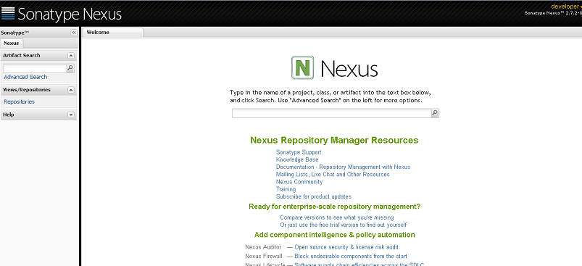
Nexus Frontend with developer rights
URL: http://localhost:8081/nexus
Credentials: admin/******
Login to Nexus!

Slide 23
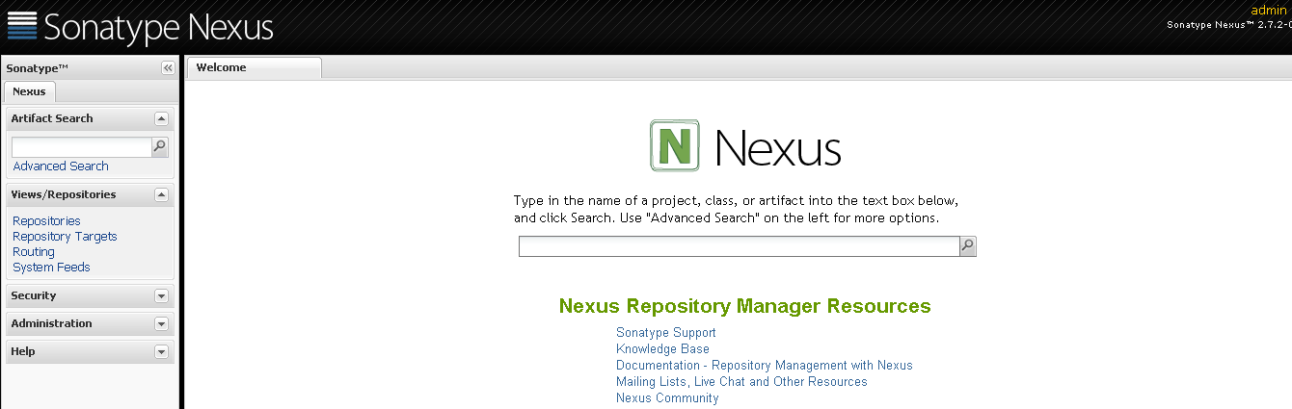
Nexus Frontend with admin rights
URL: http://localhost:8081/nexus
Admin credentials: admin/admin123
Login to Nexus with admin rights!

Slide 24
Nexus Repositories types
Repository
Hosted – hosted by Nexus
Proxy – gateway to external repositories
Virtual – adaptor for different type of repositories
Repository Groups
Ordered list of repositories
Determines artifact resolution order

Slide 25
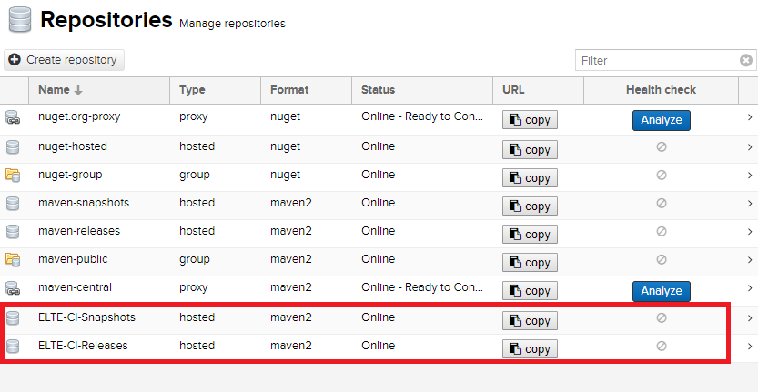
Nexus hosted repositories
ELTE-CI Snapshots
Repository Policy: Snapshot
Deployment Policy: Allow redeploy
ELTE-CI Releases
Repository Policy: Release
Deployment Policy: Disable redeploy
Check Nexus ELTE-CI Releases and Snapshots Repositories!

Slide 26
Nexus deploy non-snapshot version
Navigate to first-project!
Alter version to 1.0 by Maven Versions plugin
Deploy it!
mvn versions:set –DnewVersion=1.0
mvn clean deploy
Try how Nexus handles released versions!

Slide 27
Thank you!
Maven in Real Projects

